Slide 1
BioMetrix
Self-Health Improvement
Team R.O.C.K.E.T.

Slide 2
Sprint 1 Goals

Slide 3
Begin migration to fragments to use with navigation drawer
Move user creation and authentication code away from the Android device
Turn LocalStorageAccess into an abstract SQLite Adapter class to “View Past Entries”
Work toward a full listing of what is going to be included in each module.

Slide 4
Sprint 1 Results

Slide 5
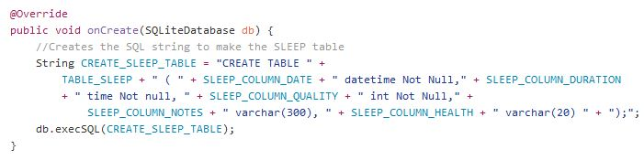
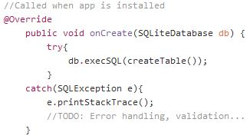
Local DB Adapter made TJ’s code abstract
//A module's table create sql statement.
protected abstract String createTable();

Slide 6
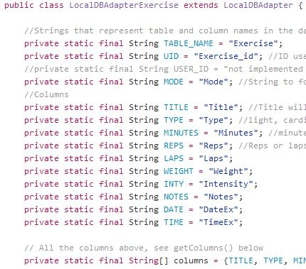
Extends SQLiteOpenHelper, Android’s way to do SQLite.
SQL code here being transactions, exceptions, and other SQLite boilerplate code.
LocalDBAdapter Base Class
abstract method{
SQL code(
methodChildMustImplement();
);
}
Child ‘Module X’ Class
Private table variables
Implemented parent methods
Specific behavior (FitBit)

Slide 7
Let’s See an Implementation
PARENT LocalDBAdapter
Inserting a new Exercise Entry
CHILD LocalDBAdapterExercise
UI
Exercise Module

Slide 8
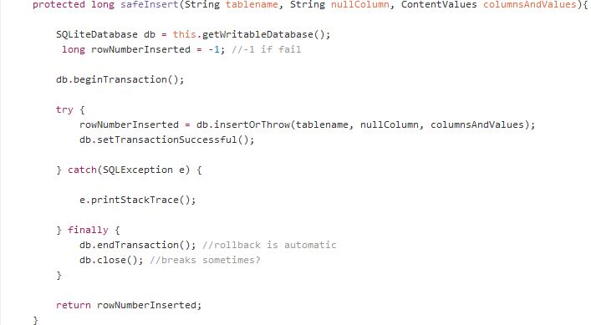
Let’s See an Implementation (Parent)
Transaction boilerplate;
ContentValues is just a set of columns & values

Slide 9
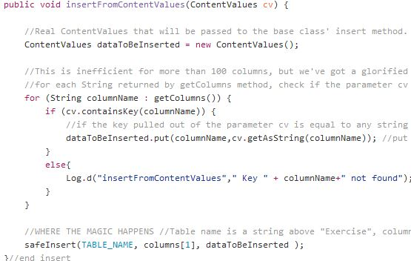
Let’s See an Implementation (Child)
Checks if column name is valid,
then calls parent method;
NullColumn is SQLiteOpenHelper’s way to autofill null columns.

Slide 10
ModuleStringHelper class
Let’s See an Implementation (UI)
How does the Exercise module fill the ContentValues?
Using a helper class I made for this sprint!
A bunch of static methods for pulling strings out of materials, and changing them to work with the DB or JP (human users)

Slide 11
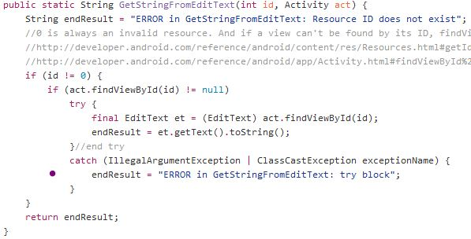
Let’s See an Implementation (UI)
ModuleStringHelper example method

Slide 12
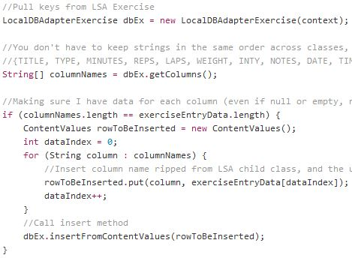
Let’s See an Implementation (UI)
Actual UI implementation
Making an instance of LDBExercise and passing a ContentValues to its insert method,
which feeds the parent method which calls the REAL SQLite insert

Slide 13
Let’s See an Implementation
PARENT LocalDBAdapter
Inserting a new Exercise Entry
CHILD LocalDBAdapterExercise
UI
Exercise Module

Slide 14
After Viewing Past Entries… Edit Past Entries!
Decided to use a calendar that interfaces with the local DB!
Too much to do in 5 days however, spent 3 days setting up Test Driven Development which also impacted how much got done in week three.

Slide 15
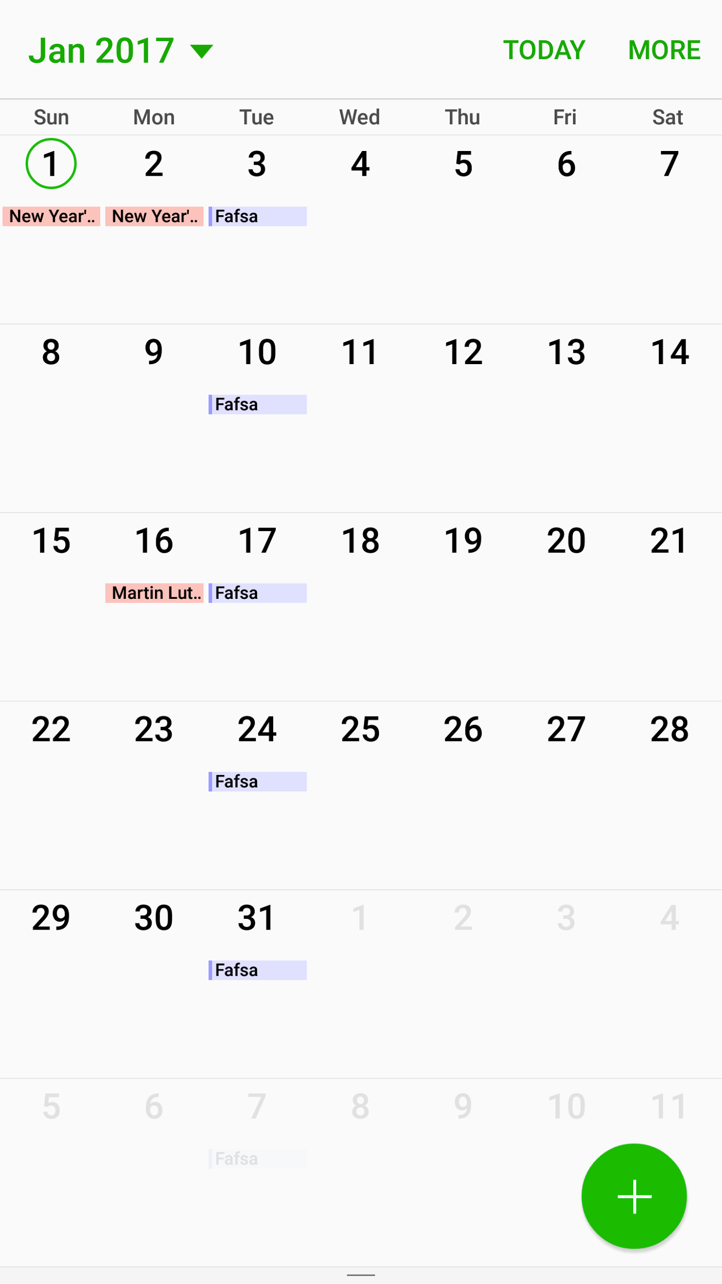
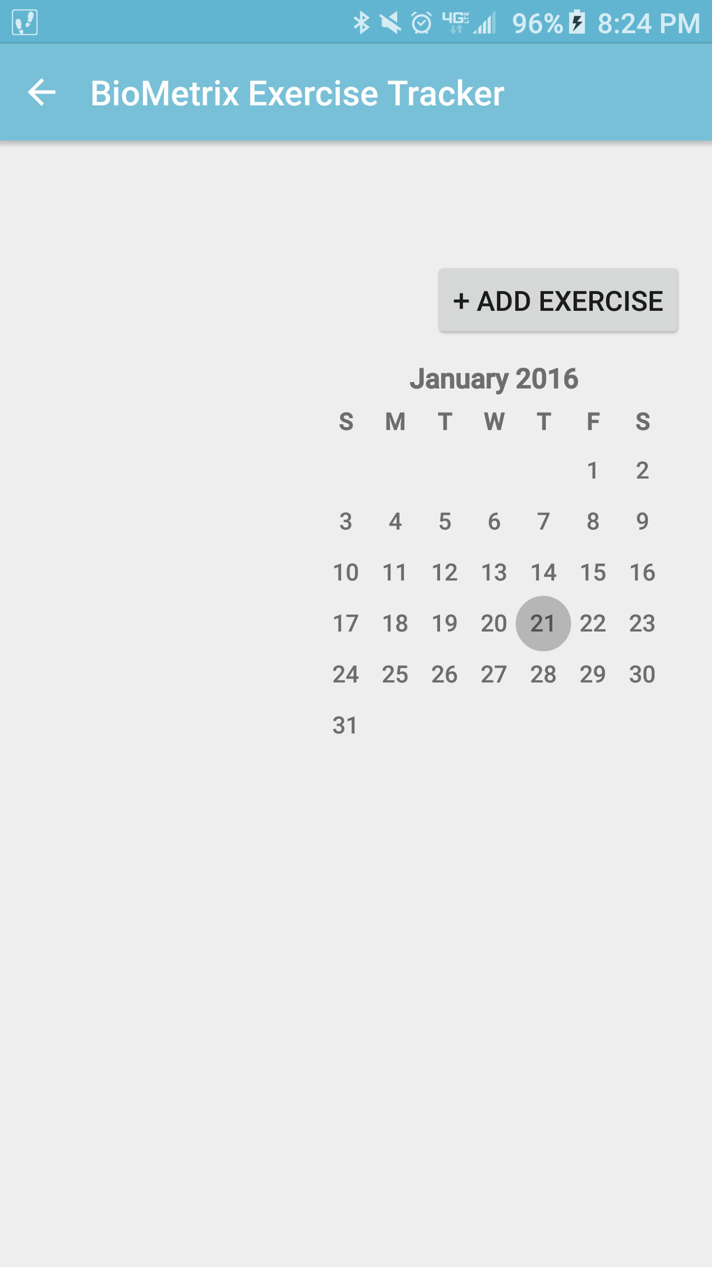
After Viewing Past Entries… Edit Past Entries!
Progress on making OG 2012 calendar work with our app’s DB and Nav drawer
→ That’s a fragment!
OG 2012 Google Calendar

Slide 16
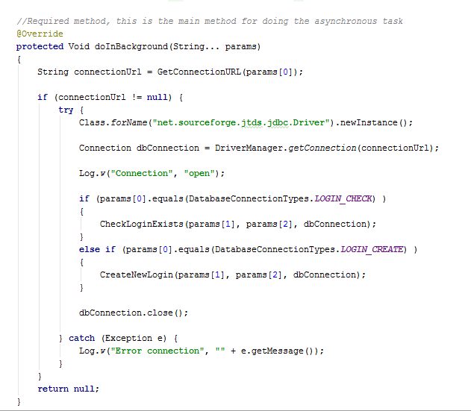
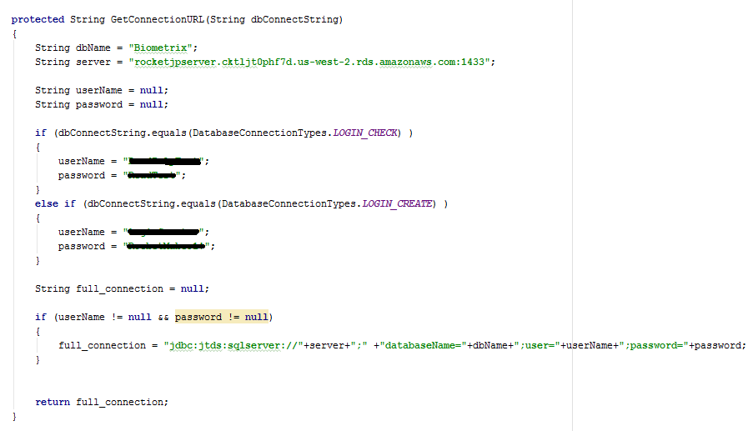
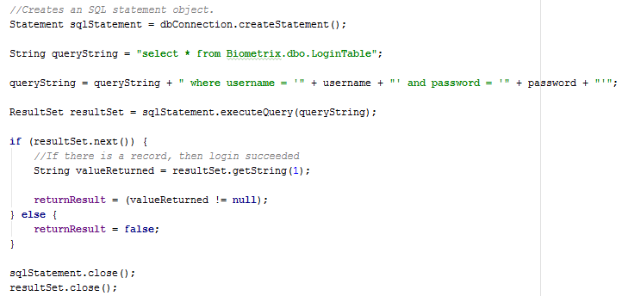
Old authentication system

Slide 17
Problems with old authentication
Makes use of the jtds jdbc driver
Stores username and password in code
Allows SQL injection
Exact user password is stored
Any IP Address had to be able to connect to the database
User logins did not mean anything
Users had no way to reset their password

Slide 18
Solution?
Amazon free tier ec2 Web Server as a middle layer
www.biometrixapp.com
Running Amazon Linux AMI (instead of Windows Server)

Slide 19
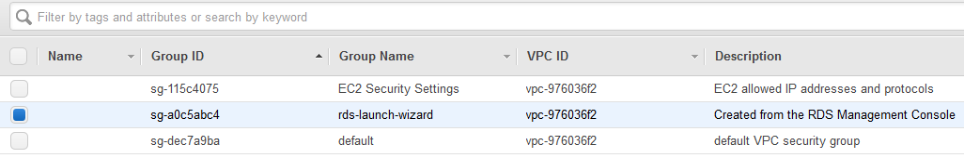
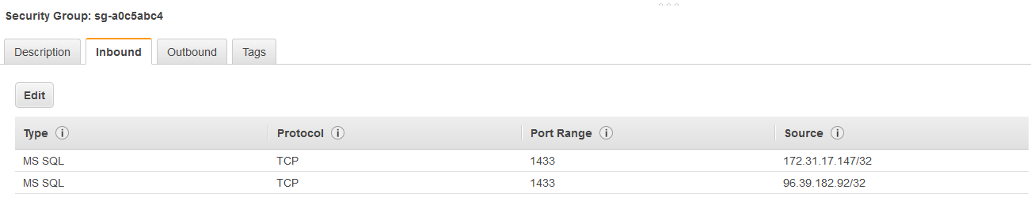
IP Addresses
“Any IP Address had to be able to connect to the database”
The webserver is now the only IP address (besides admin IPs) that allow SQL connections

Slide 20
Driver/Database Connection
“Makes use of the jtds jdbc driver”
Now uses FreeTDS driver on webserver to connect
Was able to remove that code and replace it with an HTTP request
HTTP request then calls php scripts on web server that handle the SQL operations

Slide 21
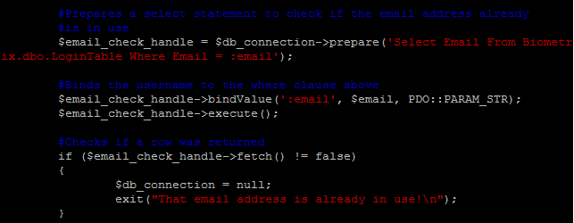
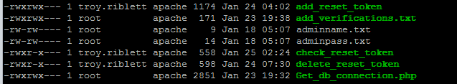
SQL storage issues
“Stores username and password in code”
“Allows SQL injection”
Uses PHP to prepare statements
Admin username and password stored in directory only apache and Biometrix developers have access to

Slide 22
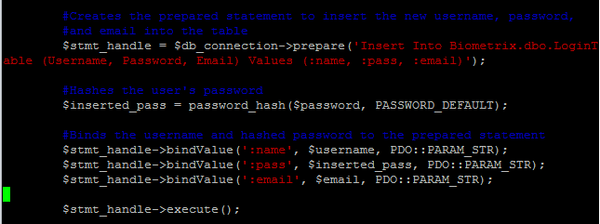
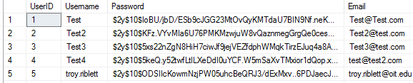
Insecure user Passwords
“Exact user password is stored”
Uses PHP (bcrypt algorithm) to hash and verify passwords
End results below

Slide 23
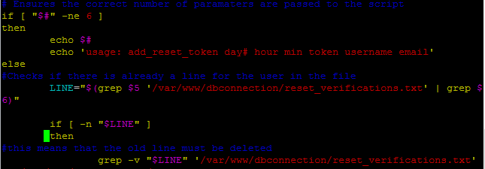
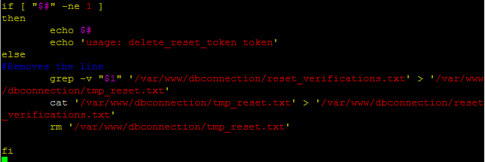
User Password Reset
“Users had no way to reset their password”
Now is an option on the android login page
Similar code for login/add user HTTP Request
Includes bash scripts on webserver to manage reset “tokens”
Sends email to user with reset information

Slide 24
User Settings
“User logins did not mean anything”
Now “logs” the user in locally by use of the LocalAccount Singleton
Stores users shared preferences as key-value pairs

Slide 25
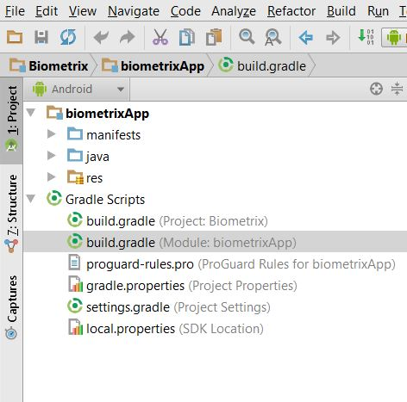
UPDATES: “Can break your ability to compile”
Source of update error.

Slide 26
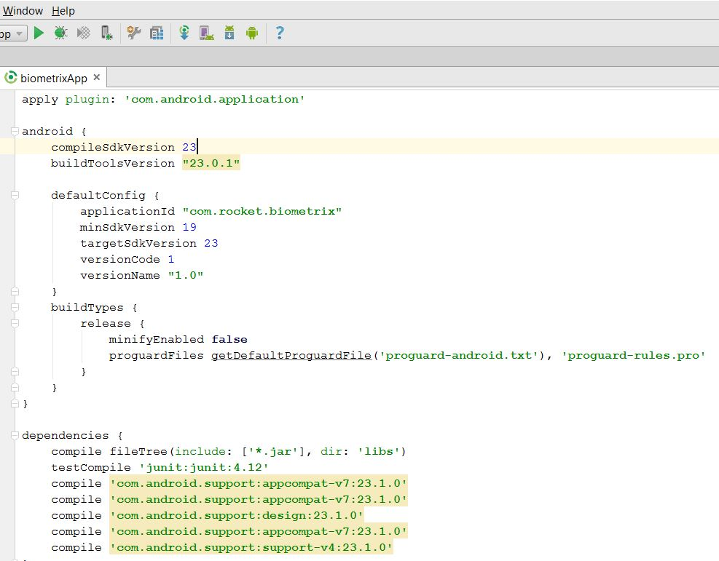
These compile version numbers must match the API you are building your project in. Updating can change these numbers.

Slide 27
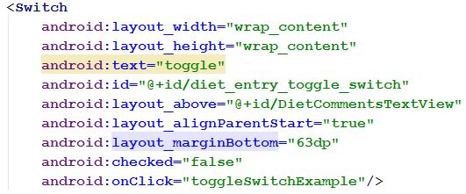
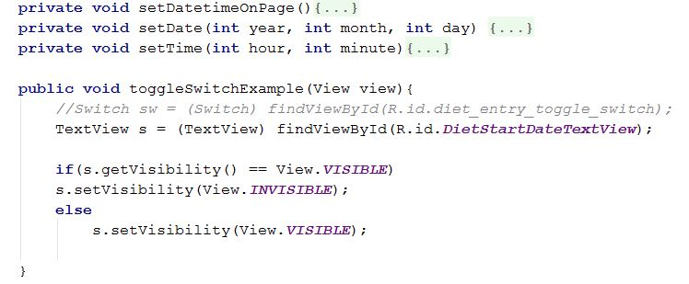
This example is the code from the content design which has the onClick event which calls the function in the .java file below.
This is the example code within the .java file that checks if the switch is toggled or not.

Slide 28
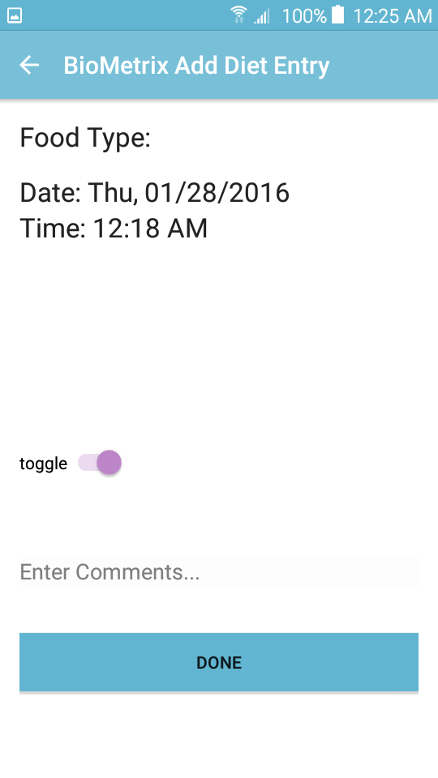
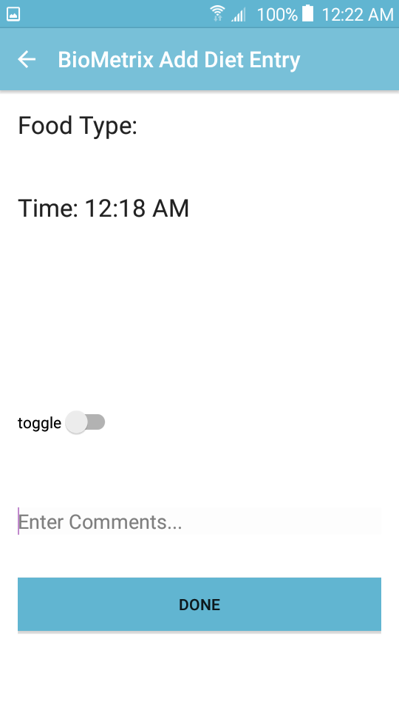
Toggled off will disable the ability to see items within the module.
By default the items within modules will be activated and the options to turn them off will be listed within a settings fragment.

Slide 29
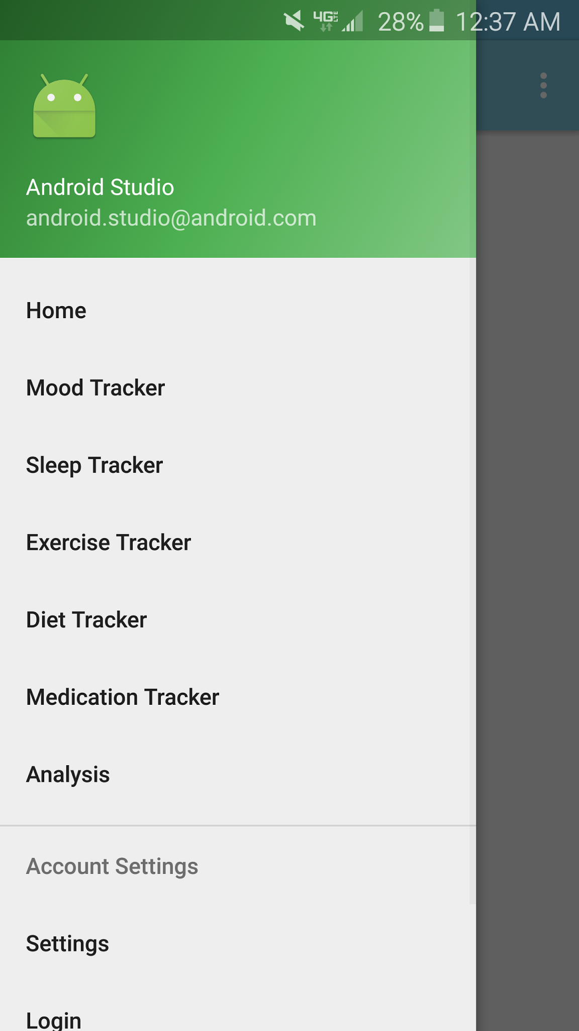
Navigation Drawer
Much more horrible to implement than we originally anticipated
Should *start* a project with this
We created a new project and are migrating code

Slide 30
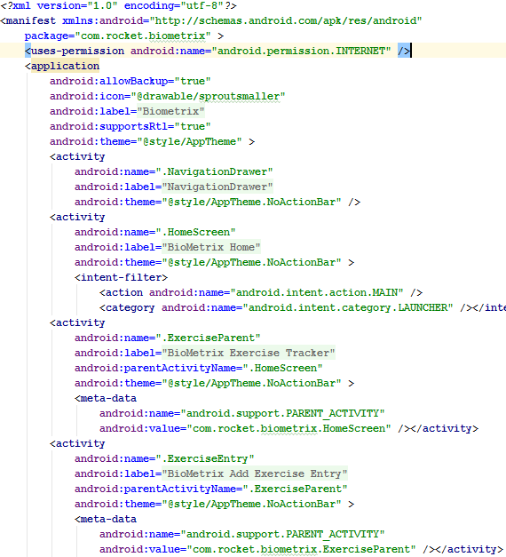
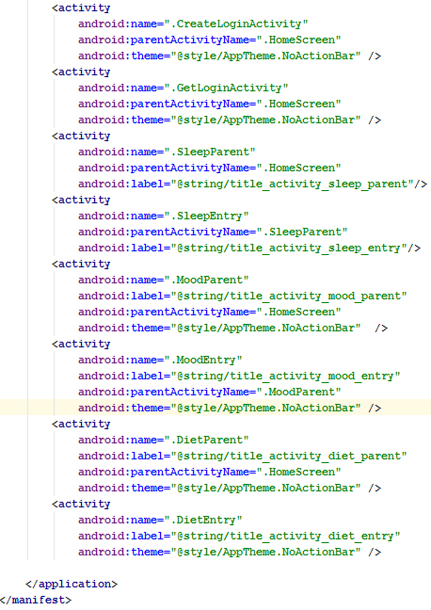
Original Android Manifest

Slide 31
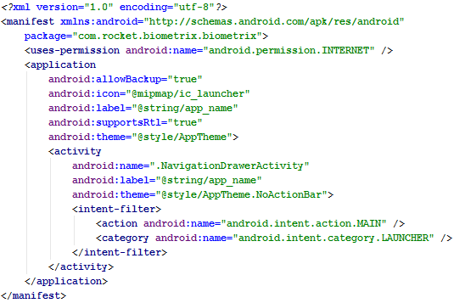
New Android Manifest

Slide 32
Fragments

Slide 33
Moving to Fragments
Moving from many activities to one
Converting all existing activities into fragments
Content XML for widgets unchanged for the most part
Java code changing a lot

Slide 34
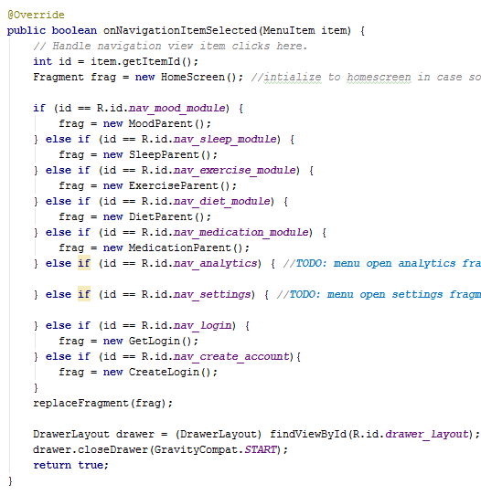
Navigation Menu

Slide 35
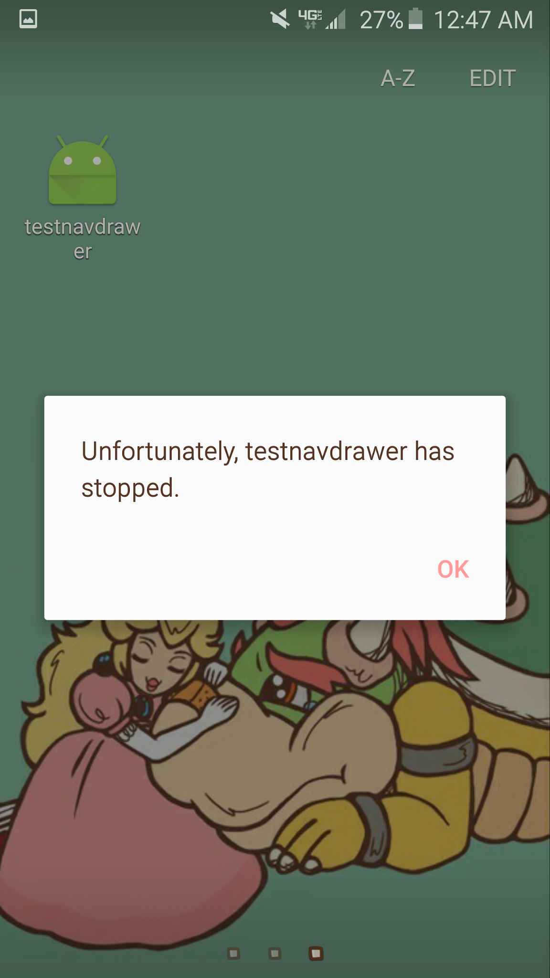
Crashing
Refactoring all functions to run as fragments
Much more time consuming and crashing than originally anticipated

Slide 36
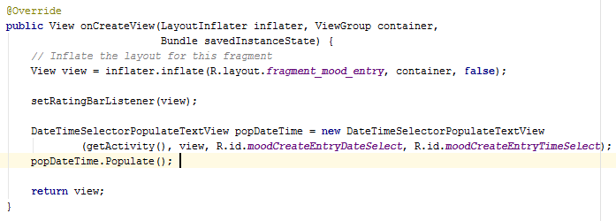
Inflating
Views
Renders a view (the fragment) in the activity at runtime

Slide 37
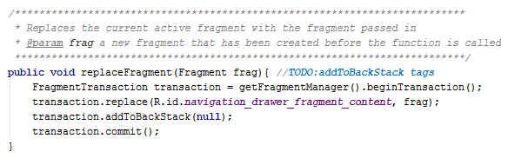
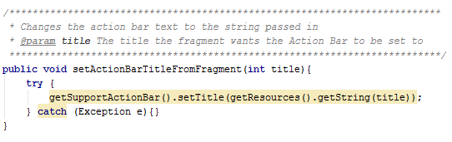
Switching Between Fragments

Slide 38
Sprint 2 Goals

Slide 39
Abstract Edit Past Entries (Finishing)
One Calendar Fragment shared by all modules
With fill from local DB
Auto-populated entry edit frags

Slide 40
Create Workout Plan
Entry integration
User Pref Integration for BMI/Gains
Notifications

Slide 41
Research FitBit and Android’s Pedometer
Using those APIs
Making it seamless

Slide 42
Additional webserver/stored data integration
User Shared Preferences
Google Account Integration
Require new users verify via email (only 1 account per user email)

Slide 43
Module completion and cleanup
Finish the complete listing of what will be included in the diet module.
Add these items to the module
Proceed with same objective for each module in the application.

Slide 44
Navigation Drawer
Convert the rest of the app to fragments
All the fragments

Slide 45
Questions?

